Slide 1

Algoritma Pemrograman Dasar :
Javascript
7
Day 8

Slide 2
1
Searching
Outline Class
2
Sorting

Slide 3
Searching
Searching is searching for a data in a data set.
This time we will discuss about 2 types of searching, namely Sequential Search and Binary Search.

Slide 4
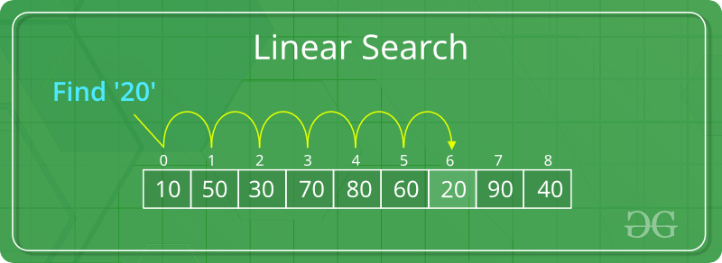
Sequential Search / Linear Search
Is a data search process with a direct search method.
This is done by matching the data to be searched with all the data in the data group.
The data matching process is carried out sequentially. One by one starting from the 1st data to the last data sequence.

Slide 5
Binary Search
Is a technique for finding a specific value in a linear array, eliminating half the data at each step.a binary search looks for the middle value (median), performs a comparison to determine whether the searched value comes before or after it, then searches for the remaining half in the same way.
The search begins by checking the value in the middle position of the list.

Slide 6
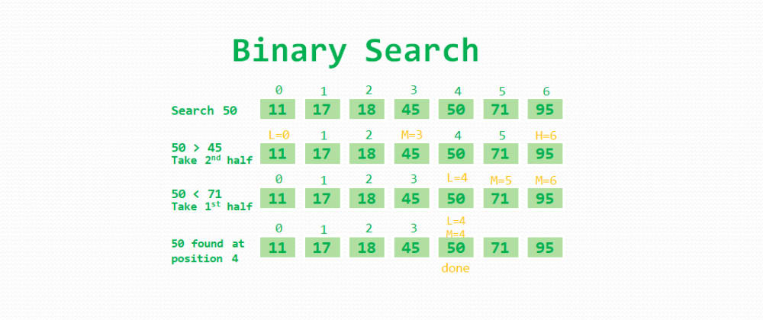

Slide 7
Sorting
Sorting is sorting data.
The data is sorted from the smallest to the largest.
The goal is to make the data neat.

Slide 8
Bubble Sort
Is a sorting process that gradually moves to the right position because that's why it's called Bubble which means bubble.
In simple terms, the Bubble Sort algorithm can be defined as sorting by exchanging data with the data next to it continuously until in a certain iteration there are no more changes.

Slide 9
Selection Sort
Is a sorting process that move elements by comparing the current element with the next element to the last element. If another element is found which is smaller than the current element, its position is recorded and then exchanged and so on.

Slide 10
Thank you

